Slide 1
Digital Signal Processing Final project
2015, Lisbon

Slide 2
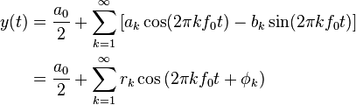
Introduction
Additive synthesis
reproduction of a given sound
uses sine waves as basic function
based on the Fourier-theory
the given sound should be Fourier-transformed
the k most relevant amplitudes and frequencies are collected
the sound is estimated with the superposition of k sine waves with the given amplitudes and frequencies
ADSR, filters, modulations and other basic functions are also implemented
implementation in MATLAB

Slide 3
Basic function
Requirements
read the audio file
do the Fourier-transformation
sort the coefficients
save the k most relevant amplitudes and frequencies
compose and sum up the elementary sine waves
Test
first with synthetic sounds
later with records of real instruments

Slide 4
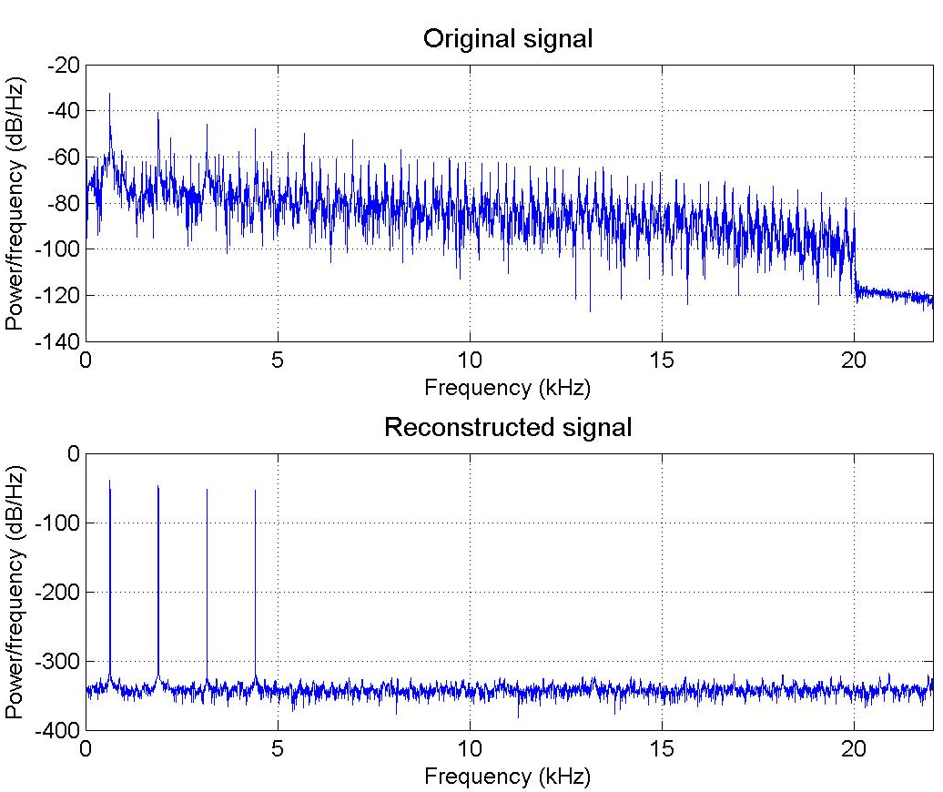

Basic function
Results
original sound is from The Prodigy – Voodoo people
k = 10
without ADSR, filters etc..

Slide 5
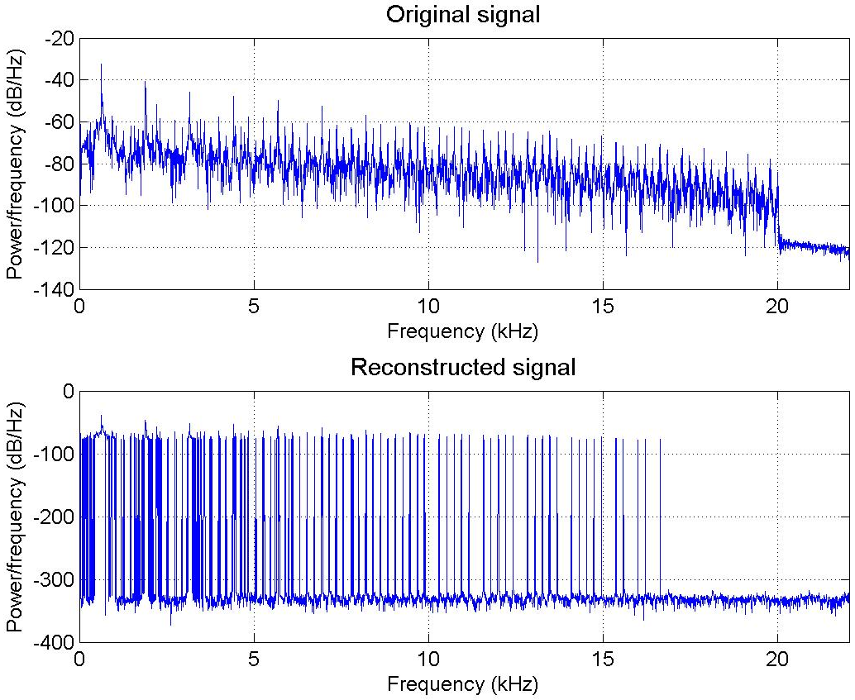
Basic function
Results
original sound is from The Prodigy – Voodoo people
k = 500
without ADSR, filters etc..

Slide 6
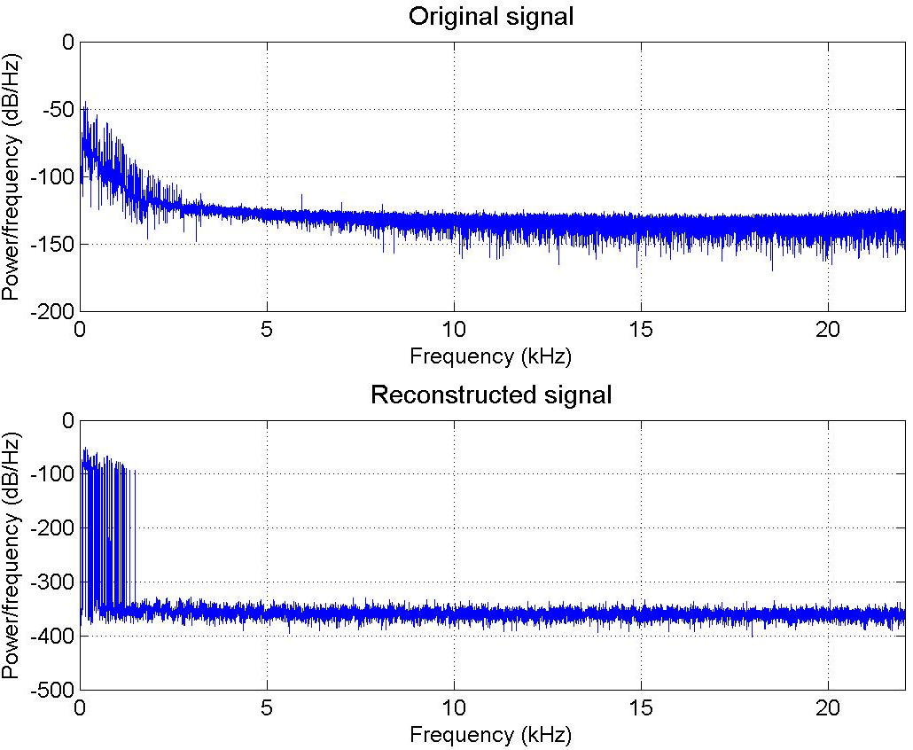
Basic function
Results
original sound is a piano sound
k = 500
without ADSR, filters etc..
more complex sound with some reverb

Slide 7
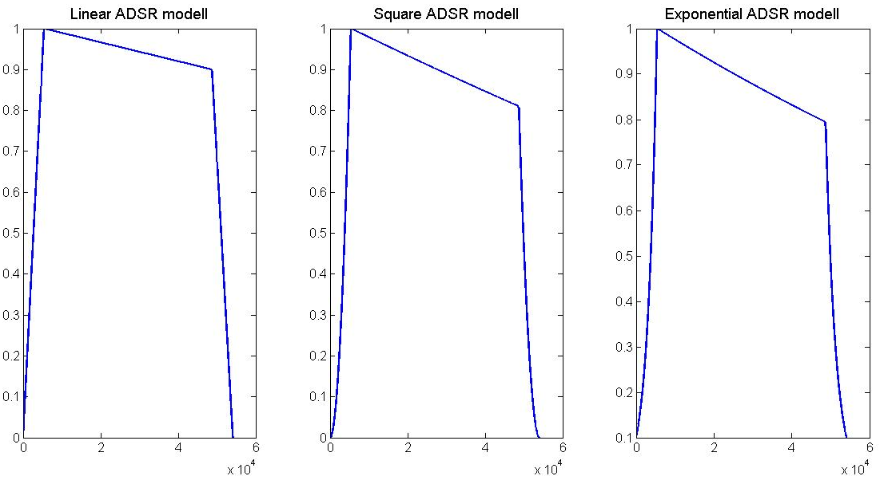
ADSR
A – attack time
D – decay time
S – sustain time and level setting is different in each case
R – release time

Slide 8
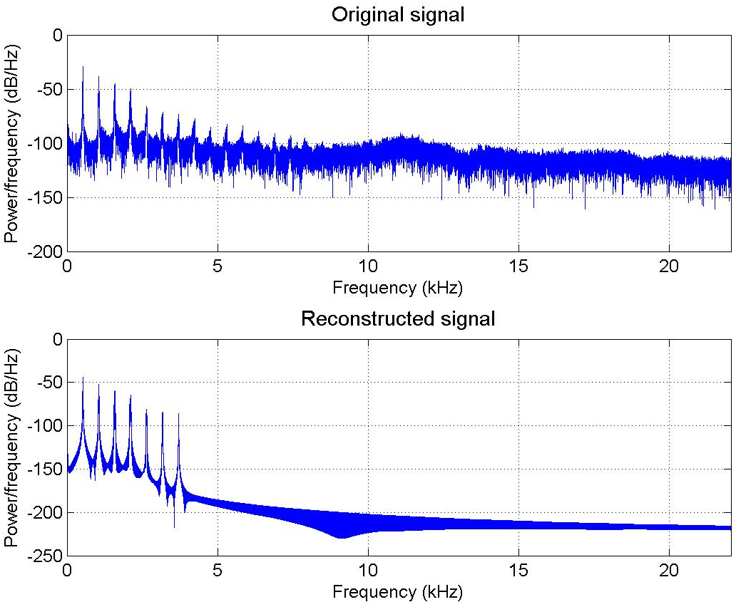
ADSR
Results
original sound is a flute sound
k = 500
with ADSR
tremolo (modulation) in the end of the sound

Slide 9
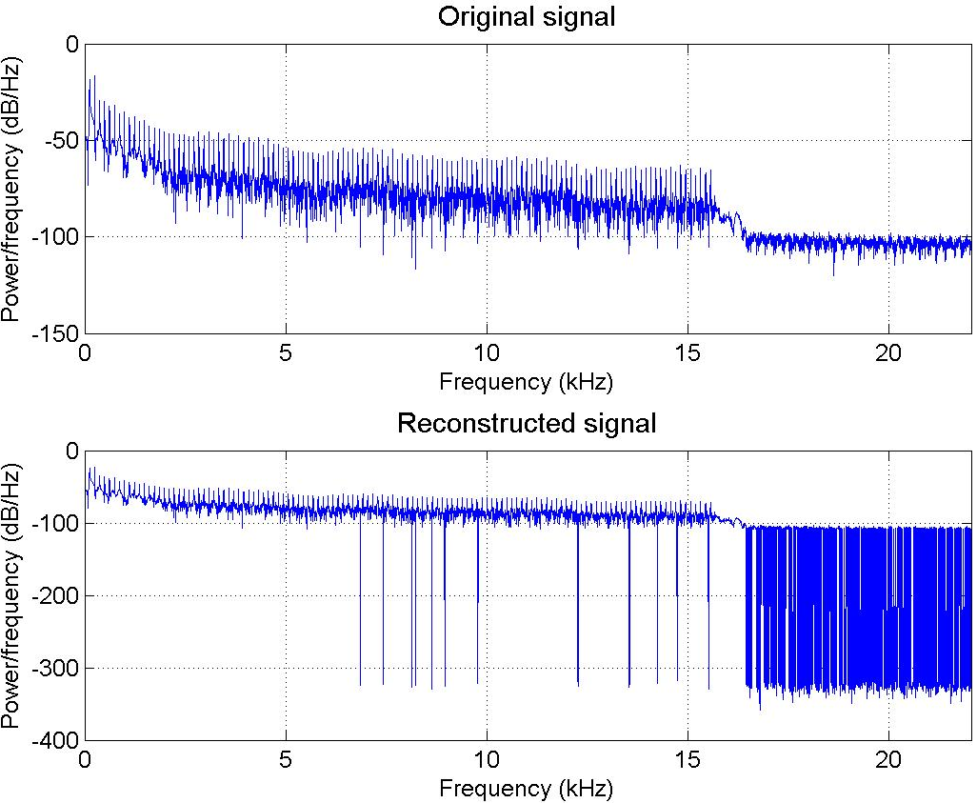
ADSR
Results
original sound is from Benny Benassi – Satisfaction
k = 4000
with ADSR
synthetic bass sound

Slide 10
Different basic functions
instead of sine waves using
square with changeable duty cycle -> odd-integer harmonics
sawtooth -> all-integer harmonics
enrichement of the sound
more content in frequency-domain
essentially these basic functions are the totality of sine waves by the Fourier-theory

Slide 11
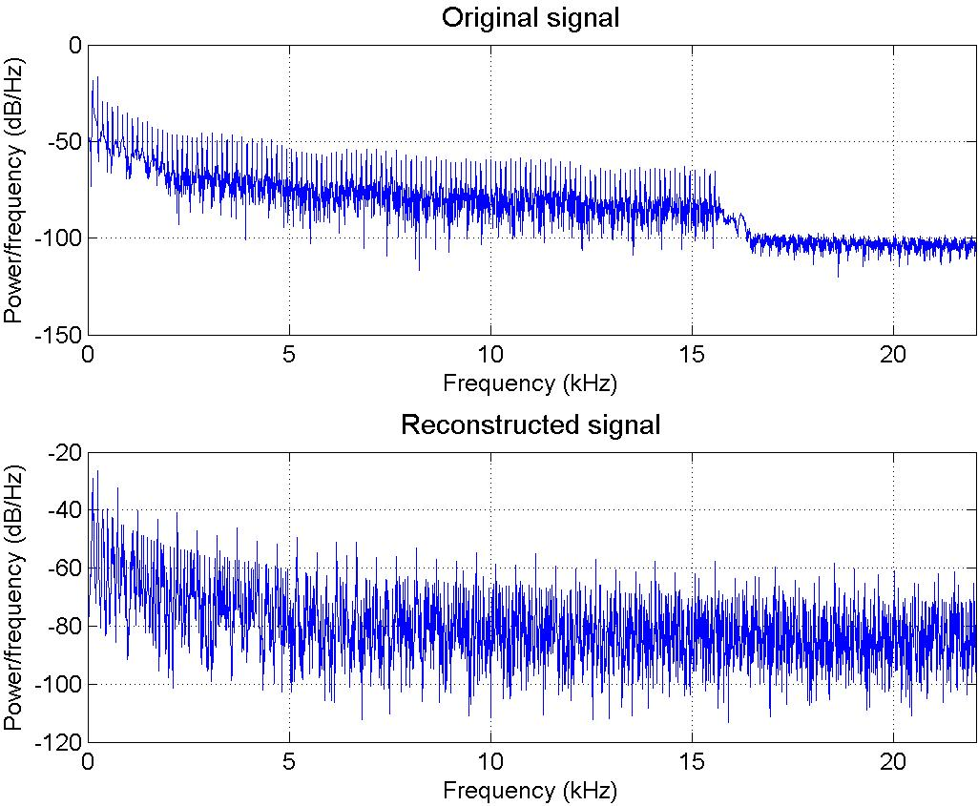
Different basic functions
Results
original sound is from Benny Benassi – Satisfaction
k = 10
with square basic functions
synthetic bass sound

Slide 12
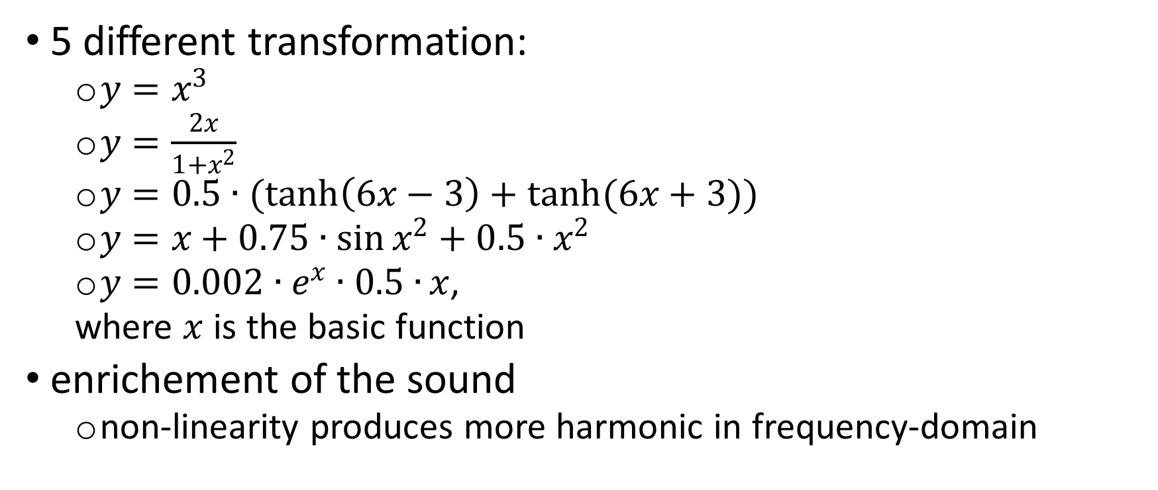
Non-linear transformation
5 different transformation:
$y=x^{3}$
$y=\frac{2x}{1+x^{2}}$
$y=0.5∙(\tanh\left(6x−3\right)+\tanh{(6x+3))}$
$y=x+0.75∙\sin{x^{2}}+0.5∙x^{2}$
$y=0.002∙e^{x}∙0.5∙{x}$,
where $x$ is the basic function
enrichement of the sound
non-linearity produces more harmonic in frequency-domain

Slide 13
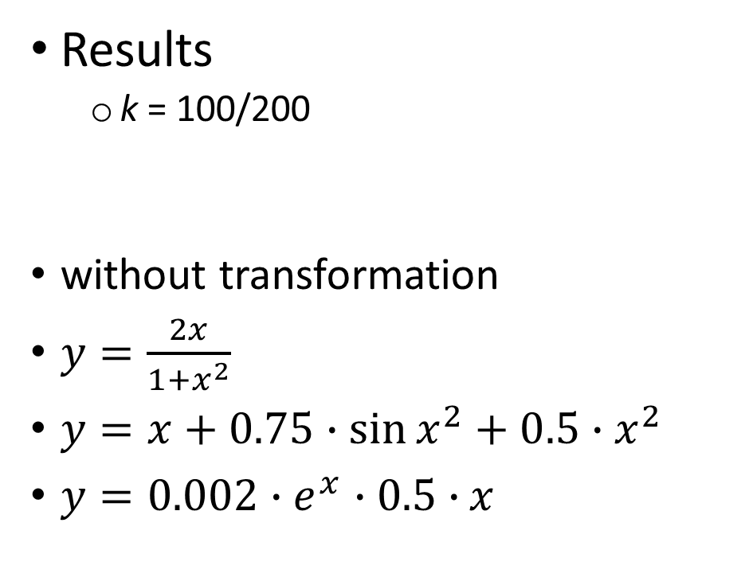
Non-linear transformation
Results
k = 100/200
without transformation
$y=\frac{2x}{1+x^{2}}$
$y=x+0.75∙\sin{x^{2}}+0.5∙x^{2}$
$y=0.002∙e^{x}∙0.5∙{x}$

Slide 14
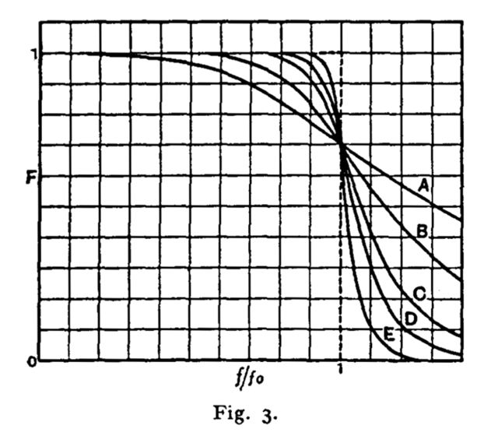
Subtractive sound synthesis
using filters to shape the sound
attenuation
enhancement
chosen filter is Butterworth filter which is designed to have as flat a frequency response as possible in the passband.
lowpass
highpass
bandpass

Slide 15
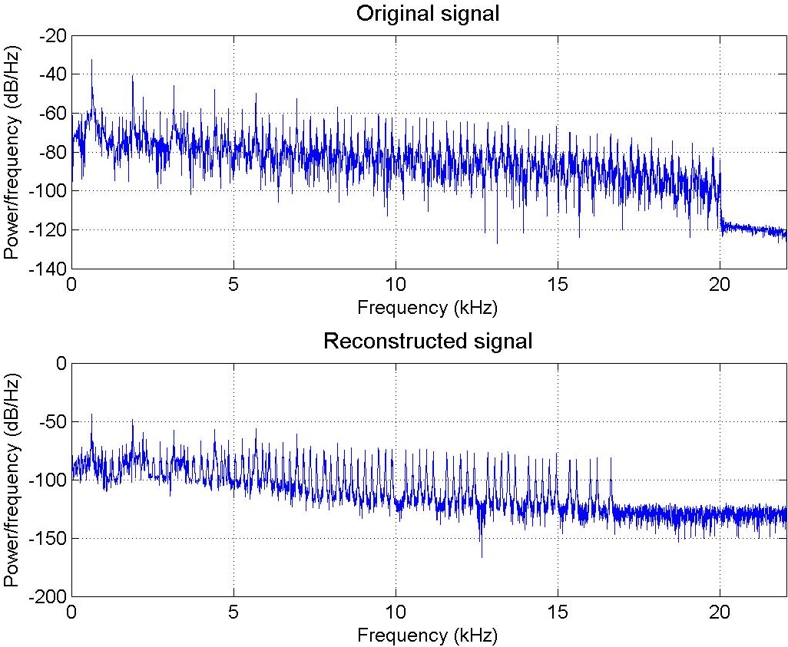
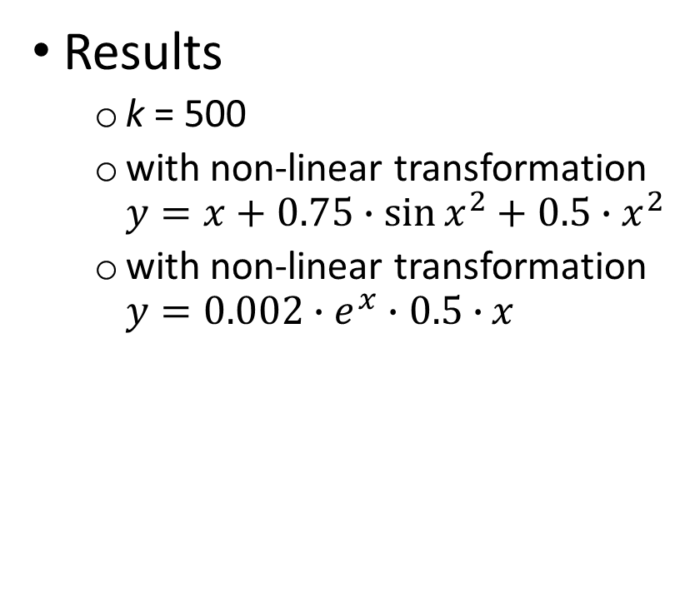
Subtractive sound synthesis
Results
k = 500
with non-linear transformation $y=x+0.75∙\sin{x^{2}}+0.5∙x^{2}$
with non-linear transformation $y=0.002∙e^{x}∙0.5∙{x}$

